Slide 1
Healthy Longevity dashboard for Sierra Leone
Tahir Bockarie, PhD
Prof. Beverley Essue, PhD
Prof. Prabhat Jha, PhD
November 2022

Slide 2
Concept: Healthy Longevity
What is Healthy Longevity ?
Defined as the capability to survive past the average age of death.
(De Benedicits and Franceschi, 2006)
What determines health and longevity?
These factor influence life expectancy: gender, genetics, access to health care, hygiene, diet and nutrition, exercise, lifestyle and crime rates.
What increases longevity?
Maintaining five healthy habits- eating a healthy diet, exercise regularly, keeping a healthy body weight, not drinking too much alcohol, and not smoking
(T.H Chan School Public Health )

Slide 3
Background: Sierra Leone
Sierra Leone’s life expectancy at birth was among the lowest in the world at 54 years in 2019
Only 25% of all deaths are reported through a centralized vital statistics system
Many deaths occur outside health facilities (mostly at home) without medical attention or documentation of cause of death
High Under-5 Child (122/1000 livebirths) and maternal mortality (1120/100,000 livebirths) rates in Sierra Leone expose the burden of premature deaths (death before age 70 years) in the country

Slide 4
Healthy longevity dashboard
A dashboard of health, social, and economic indicators that can be used to monitor and guide investments in NCDs and health longevity in a country
Broadly, these indicators can be categorized in 10 domains:
Life expectancy | Access to care for NCDs/NCD management
Mortality at different life stages | Education
Child health (immunization and healthy growth) | Gender outcomes
Adult vaccinations | Labour force
NCD risk factors | Social protection

Slide 5
Healthy longevity dashboard
To assess the performance of a country relative to other countries in the same World Bank income strata, a score out of 100 is assigned using two approaches:
Percentile rank approach- calculated using percentile rank as:
Percentile rank = $\frac{M+(0.5∗R)}{Y} x 100\%$, where M = number of values below x
R = number of values equal to x
Y = number of values
Z-score approach- calculated using z-score and z-table, assuming normal distribution
For Sierra Leone, we included data from 23 low-income countries with >7m population or about 0.1% of the world population in 2020
Based on the score, the country is assigned into quartiles, colour-coded as:
 | <25% |  | 25 - <50% |  | 50 - <75% |  | >-75%

Slide 6
Life Expectancy
Life expectancy at birth
 | Males | Females
Sierra Leone | 59.6 | 61.9
Worst-case scenario, Somalia | 54.0 | 59.2
Best-case scenario, Syrian Arab Republic (m), Dem. Republic of Korea (f) | 71.2 | 75.7
Score (based on z-score approach)
Life expectancy at age 60
 | Males | Females
Sierra Leone | 16.4 | 17.4
Worst-case scenario, Somalia (m), Afghanistan (f) | 13.2 | 15.1
Best-case scenario, Syrian Arab Republic (m), Dem. Republic of Korea (f) | 18.2 | 20.8
Score (based on z-score approach)

Slide 7
Mortality at different ages
Mortality rate (per 100,000 population) | Under 5 years | 5-14 years | 15-29 years
 | Both Sexes | Box Sexes | Male | Female
Sierra Leone | 107 | 196 | 199 | 192
Worst-case scenario | 114 | 358 | 387 | 329
Best-case scenario | 16 | 78 | 100 | 56
Score (based on z-score approach)

Slide 8
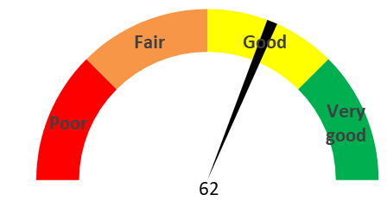
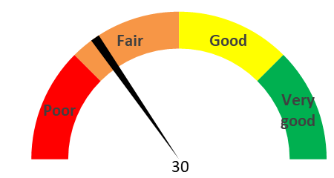
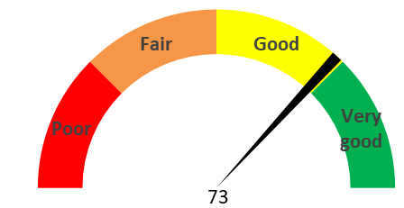
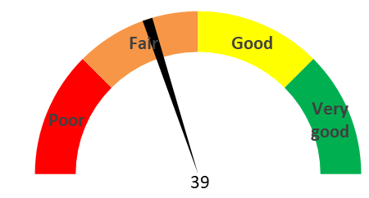
Mortality at different ages
Mortality rate (per 100,000 population) | 30-69 years |  | 70 years +
 | Male | Female | Male | Female
Sierra Leone | 895 | 928 | 8,103 | 7,588
Worst-case scenario | 1,471 | 1,868 | 10,861 | 9,549
Best-case scenario | 489 | 591 | 7,496 | 5,979
Score (based on z-score approach)

Slide 9
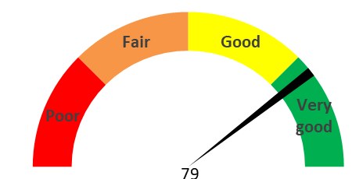
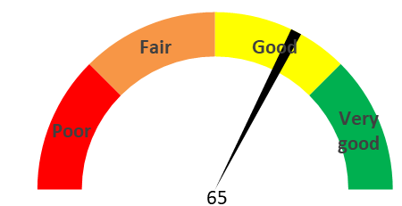
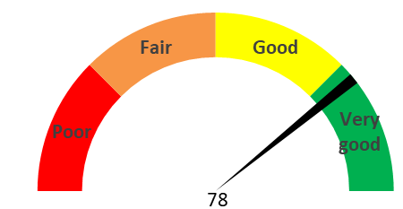
Child health (immunization)
Healthy growth (children under 5)
 | Not stunted | Not wasted | Not underweight
Sierra Leone | 74 | 94 | 87
Worst-case scenario | 49 | 77 | 60
Best-case scenario | 81 | 99 | 92
Score (based on z-score approach)

Slide 10
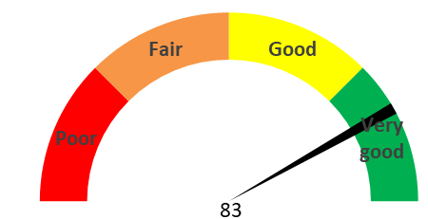
Adult immunization
 | Tetanus vaccination for pregnant women | Two doses of COVID-19 vaccinations | Pneumococcal conjugate vaccine for adults aged 65+ | Flu vaccination | Herpes zoster (shingles)
Sierra Leone | 93 | 29 | 87
Worst-case scenario | 60 | 0 | 60
Best-case scenario | 98 | 67 | 92
Score (based on z-score approach)

Slide 11
Risk factors
Risk factors (Tobacco use, harmful use of alcohol, obesity)
 | Indicators (% population | Score Male (%) | Score Female (%)
Tobacco use | Do not use tobacco use, age 15+ | 27 | 4
 | Do not smoke cigarettes, aged 15+ | 31 | 1
Alcohol use | Do not practice harmful use of alcohol, age 15+ who | 31 | 44
Obesity | Not overweight or obese, age 20+ years | 56 | 40
Diabetes | Do not have type 2 diabetes, age 15+ years | 98 | 98
Hypertension | Do not have hypertension, age 15+ years | 13 | 10

Slide 12
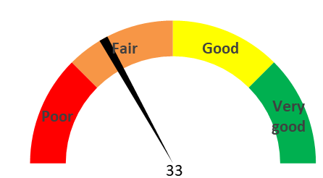
NCD Care Management
Access to antihypertensive medication
% of population aged 30-79 with hypertension that are currently taking antihypertensive medication | % population |  | % population | Score (based on z-score approach)
 | Sierra Leone | Worst case scenario (Rwanda) | Best cause scenario (Dem. People’s Republic of Korea (m), Afghanistan (f))
Males | 16 | 10 | 29
Females | 24 | 11 | 54

Slide 13
Conclusion
Out of 10 indictors, 5 scored ‘good/very good’ and another 5 ‘scored poor/ fair’
No data on other lifestyle risk factors (i.e., salt intake) and Universal Health Insurance
Lack of data and reliability on modelled data rather than actual country data → investments on data systems for monitoring and surveillance
Unknowingly, Sierra Leone is making progress towards healthy longevity for all.
A longevity society however requires an increased focus on diverse needs and circumstances and policies designed around healthy ageing for all.
Improvements to other healthy longevity indicators is required to achieving substantial changes in life course and social norms for Sierra Leone to achieve its Sustainable Development Goals by 2030

Slide 14
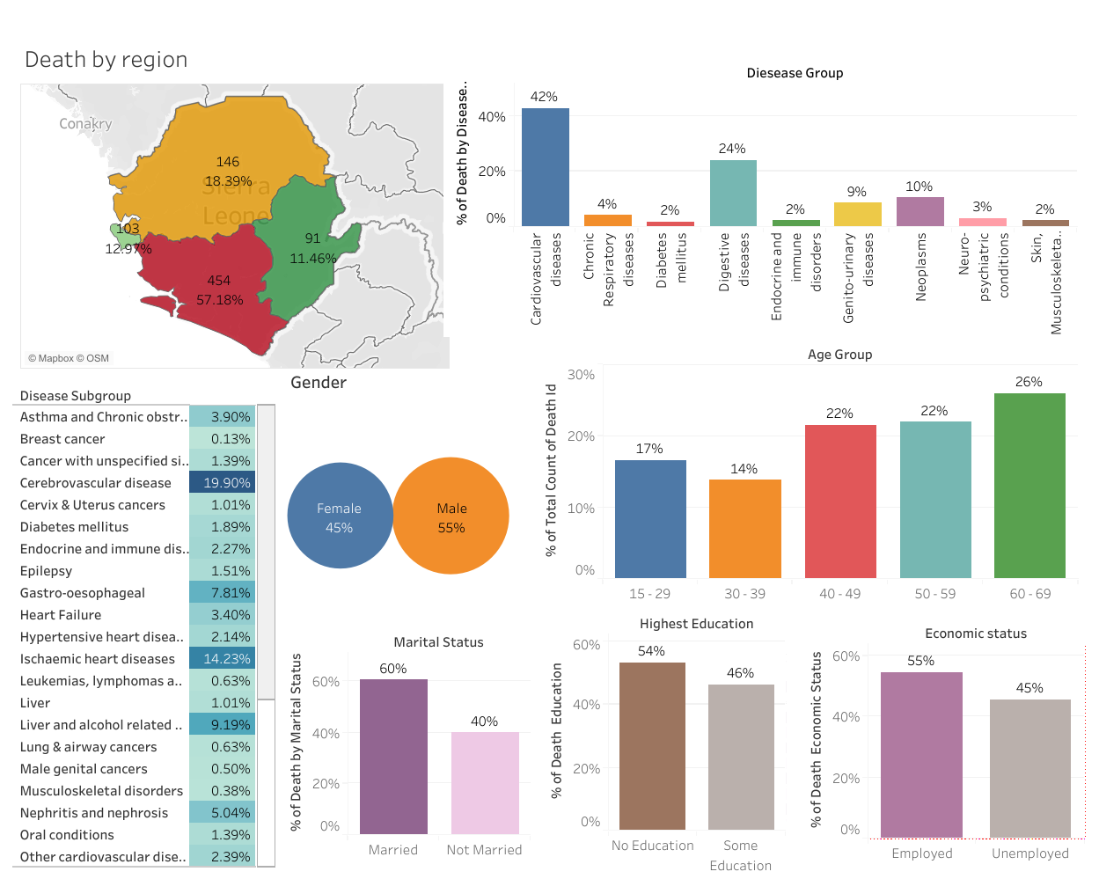
COMSA Data: Tableau dashboard on cause of deaths by Non-communicable diseases in Sierra Lone 2018-2020
https://public.tableau.com/app/profile/tai2271/viz/CauseofdeathbyNon-communicablediseasesNCDsbetween2018-2020inpersonsaged15to69yearsinSierraLeone__16586093789870/Dashboard1

Slide 15
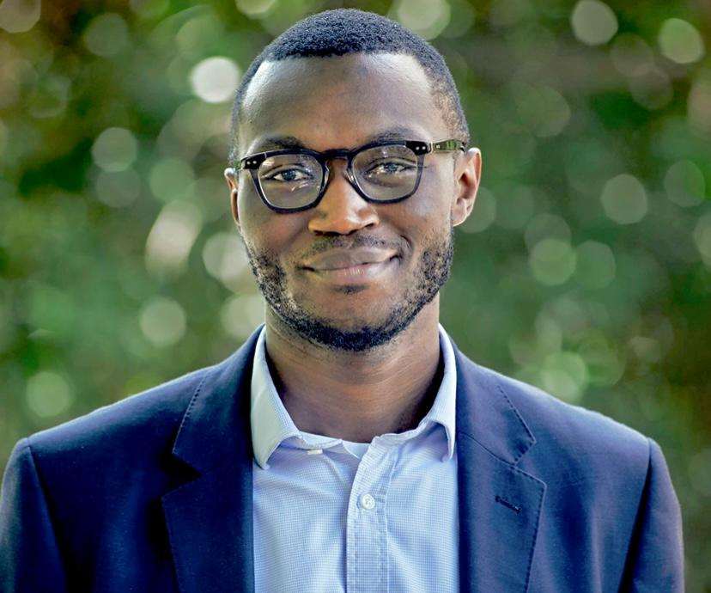
Thanks for listening
Tahir Bockarie, PhD (Warwick)
Email: tbockarie@hotmail.co.uk I t.bockarie.fs@odi.org
Twitter: Tai_Bock
Tel: +44 754 0250 917
Current role: ODI Fellow 22-24 (Sierra Leone, Ministry of Health and Sanitation)
Ex: NHS England (MedTech and Digital Technology) I Tony Blair Global Institute for Change (Strategy) I Queen Elizabeth Advanced Scholar

